Slide 1
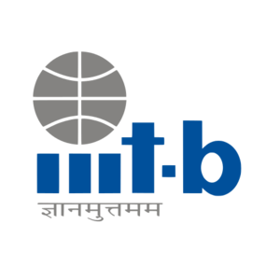

DevOps On Azure

Slide 2



What is DevOps
DevOps combines development (Dev) and operations (Ops) to unite people, process, and technology in application planning, development, delivery, and operations.
DevOps enables coordination and collaboration between formerly siloed roles like development, IT operations, quality engineering, and security.
Teams adopt DevOps culture, practices, and tools to increase confidence in the applications they build, respond better to customer needs, and achieve business goals faster
Notes:
DevOps combines development (Dev) and operations (Ops) to unite people, process, and technology in application planning, development, delivery, and operations.
DevOps enables coordination and collaboration between formerly siloed roles like development, IT operations, quality engineering, and security.
Teams adopt DevOps culture, practices, and tools to increase confidence in the applications they build, respond better to customer needs, and achieve business goals faster

Slide 3
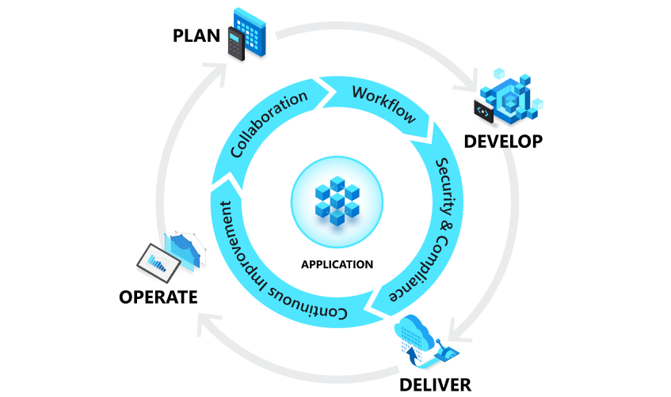
DevOps and the application lifecycle
DevOps influences the application lifecycle throughout its planning, development, delivery, and operations phases

Slide 4
DevOps goals and benefits
1. Accelerate time to market
2. Adapt to the market and competition
3. Maintain system stability and reliability
4. Improve the mean time to recovery

Slide 5
DevOps Practices
Continuous integration and continuous delivery (CI/CD)
Version Control
Agile Software Development
Infrastructure as Code
Configuration Management
Continuous Monitoring
Planning
Development
Deliver
Operations

Slide 6
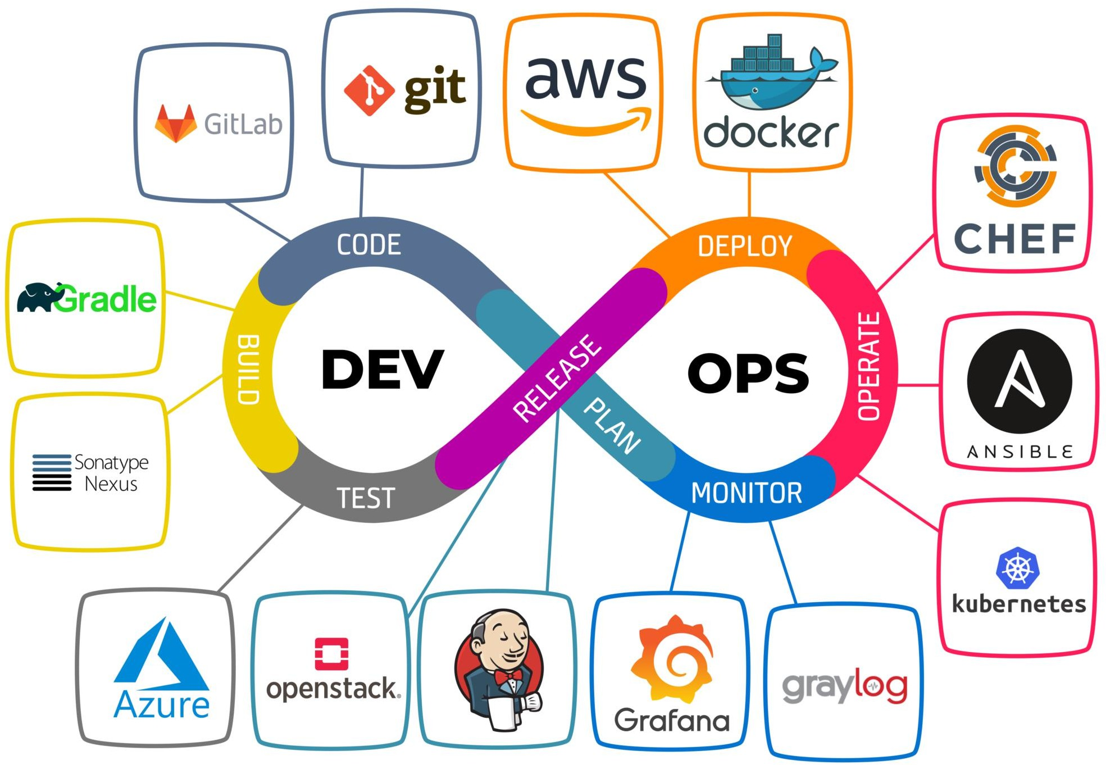

Slide 7
What is Agile?
Agile is a term that describes approaches to software development that emphasize incremental delivery, team collaboration, continual planning, and continual learning.
Agile Manifesto:-
Individuals and interactions over processes and tools.
Working software over comprehensive documentation.
Customer collaboration over contract negotiation.
Responding to change over following a plan.

Slide 8
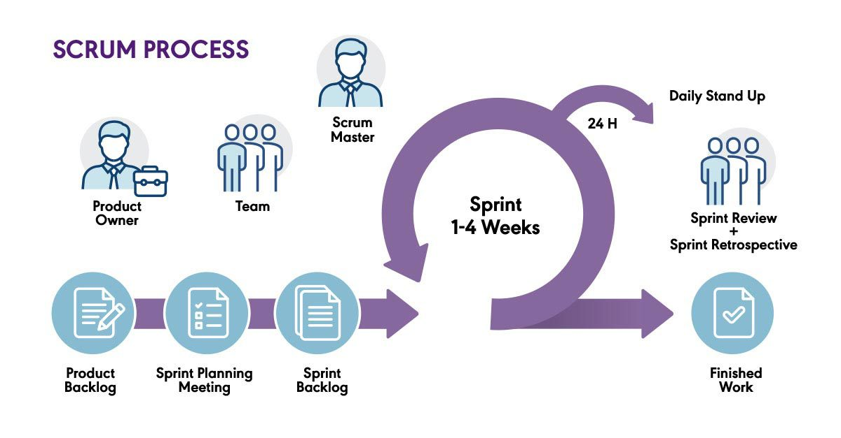
Agile methods and practices
Notes:
Agile methods, which are often called frameworks, are comprehensive approaches to phases of the DevOps lifecycle: planning, development, delivery, and operations.
Scrum is the most common Agile framework, and the one that most people start with. Agile practices, on the other hand, are techniques that are applied during phases of the software development lifecycle.
Planning Poker is a collaborative estimation practice that's designed to encourage team members to share their understanding of what done means. Many people find the process fun, and it has proven to help foster teamwork and better estimates.
Continuous integration (CI) is a common Agile engineering practice that involves integrating code changes into the main branch frequently. An automated build verifies changes. As a result, there's a reduction in integration debt and a continually shippable main branch.

Slide 9
What is Git
Git is a distributed version control system, which means that a local clone of the project is a complete version control repository.
These fully functional local repositories make it easy to work offline or remotely.
Developers commit their work locally, and then sync their copy of the repository with the copy on the server

Slide 10
Git Basics
1. Commits: Saving Changes
  Each saved change creates a commit, capturing a “snapshot” of all files.
  Commits link to form a history, making it easy to view, revert, or inspect past changes.
  Each commit has a unique ID to track changes securely.
2. Branches: Parallel Development
  Branches are separate lines of development, allowing multiple people to work without interference.
  When work is done, branches are merged into the main branch.
3. Staging & Committing: The Workflow
  Changes are first modified in the working directory.
  Staged changes are selected for the next commit.
  Once ready, staged changes are committed and added to project history.

Slide 11
Benefits of Git
Simultaneous Development
Faster Releases
Built-in Integration
Strong Community Support
Works with any team
Pull Requests
Branch Policies

Slide 12
Continuous Delivery
Continuous delivery is all about creating a repeatable and reliable process for delivering software in order to deliver high value software to our customers fast!

Slide 13
What is Azure DevOps
Azure DevOps is a set of tools and processes that supports a collaborative culture, bringing together developers, project managers, and contributors to develop software.
It enables organizations to build and improve products at a faster pace than traditional development approaches, offering both cloud-based (Azure DevOps Services) and on-premises (Azure DevOps Server) solutions.

Slide 14
Azure DevOps Services
Azure DevOps services gives you access to cloud build and deployment servers, and application insights.
Choose Azure DevOps services if you want the following outcomes:
  Quick set-up
  Maintenance free operations
  Easy collaborations across domains
  Elastic scale
  Rock-solid Security

Slide 15
Azure DevOps Server
Azure DevOps Server supports integration with GitHub Enterprise Server repositories.
When you deploy Azure DevOps Server, you can also configure the following servers or integration points:
  Build server supports on-premises and cloud-hosted builds.
  SQL Server and SQL Analysis Server support SQL Server Reports and the ability to create Excel pivot charts based on the cube.

Slide 16
Overview of Azure DevOps Services

Slide 17
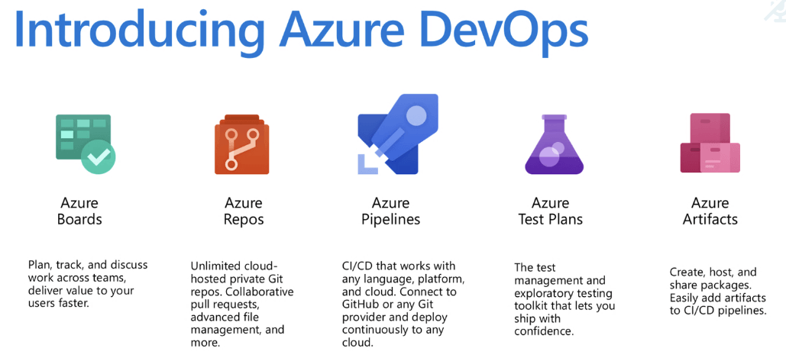

Slide 18
Dashboards
Azure DevOps provides a powerful dashboard interface that allows you to create a personalized view of your project’s data and workflows
Here’s how you can make the most of the Dashboards feature:
  Add, configure, and manage dashboards
  Configure widgets
  Navigate quickly
  Use extensibility points

Slide 19
Azure Boards
Azure Boards is a tool within Azure DevOps that helps teams plan, track, and discuss work across the development process.
Azure Boards provides the following Agile tools designed to streamline planning and tracking across your projects:
  Work item management
  Queries and charts
  Backlog Handling
  Sprint Planning
  Task board utilization
  Workflow visualization
  Portfolio management
  Scrum meetings

Slide 20

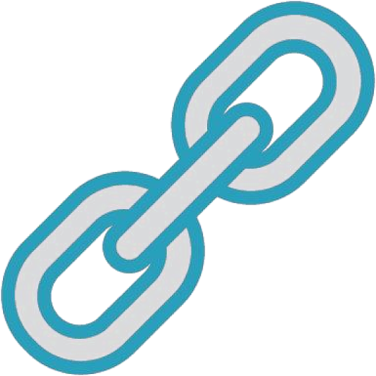





Boards
Work Items
Traceability
Planning
Kanban
Backlog
Sprint

Slide 21
Azure Repos
Source or version control systems are pivotal in enabling developers to collaborate seamlessly on codebases and maintain a comprehensive history of changes.
These systems are indispensable for projects involving multiple developers, ensuring consistency and coordination throughout the development process.

Slide 22
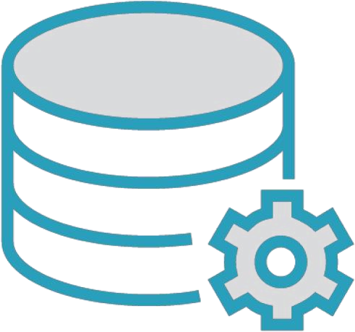
Repos
TFVC
Git
Pull requests
Branch policies Hooks for CI/CD

Slide 23
Git
Git is a version control system where each developer has a local copy of the entire repository, which allows for offline work and easy branching and merging.
You can do the following tasks with Azure Repos for Git:
  Review Files
  Download and edit files
  Manage commits
  Use pull requests
  Use Git tags

Slide 24
Team Foundation Version Control(TFVC)
It is a centralized version control system that simplifies code management.
TFVC includes the following key features:
  Single version workflow
  Server-side History
  Path based branching

Slide 25
Azure Pipelines
Azure Pipelines stands at the forefront of this endeavor by automating the build, test, and release processes.
Azure Pipelines includes the following features:
  Continuous Integration
  Continuous Delivery
  Build automation
  Release management
  Approval Workflows
  Release Tracking

Slide 26
Azure Test Plans
Azure Test Plans is a comprehensive service designed to facilitate the creation, management, and execution of various testing methodologies, including manual, exploratory, and automated tests.
Azure Test Plans includes the following key features:
  Workflow customization
  Traceability
  Test selection
  User-friendly interface
  Reuseable elements
  Collaboration
  Cross-platform execution
  Activity monitoring

Slide 27
Service Hooks
Service hooks in Azure DevOps empower you to automate and streamline interactions with other services, responding swiftly to events within your projects.
Utilize Service hooks in the following ways:
  Custom app integration
  Service targets

Slide 28
Azure cloud-hosted services
Azure offers a robust array of cloud-hosted services that are essential for the development and deployment of applications.
Key Benefits:
  Comprehensive support
  Integration with Azure DevOps

Slide 29
Administrative Services
Managing a collaborative software development environment is streamlined with Azure DevOps, which offers various features and tasks tailored for administration.
Accessible administration:
  Web-Portal management
  Comprehensive settings

Slide 30
Azure Artifacts
Allows teams to share packages such as Maven, npm, NuGet, and more from public and private sources and integrate package sharing into your pipelines.

Slide 31

Artifacts
Package management NuGet
NPM
Artifact repo
Track usage of externalpackages
Traceability

Slide 32
Hands-on: Create an Organization
Steps:-
Create an organization or project collection
Manage your project
Manage your organization or collection
Add users to a project or team
Manage teams and configure team tools
Change individual permissions
Grant or restrict permissions to select tasks
Notes:
https://learn.microsoft.com/en-us/azure/devops/organizations/accounts/create-organization?view=azure-devops

Slide 33
Thank You!

